Slide 1
Randomized Policy Optimization for Optimal Stopping
Ethan Babel, Scott Klosen, Simon Rupp
April 2025

Slide 2
Introduction
Problem Statement: Choose when to stop a stochastic process to maximize reward
Applications/Relevance: Finance, operations, healthcare
Presentation Overview:
Background and definitions
Optimal-Stopping Algorithms (Exact and Approximate)
Application of LSM and RPO in Finance

Slide 3
Motivation
Guan & Mišić (2022): “Randomized Policy Optimization for Optimal Stopping”
Why randomized?
Deterministic (non-randomized) policies yield non-differentiable objectives (no gradients)
Randomized policies smooth objective
Comparing against the popular deterministic optimal stopping algorithm: Least Squares Monte Carlo (LSM) - Longstaff & Schwartz (2001)

Slide 4
Stochastic Processes
Stochastic process is a collection of random variables {X_{t}}t∈T indexed by time t, where each X_{t} takes values in a state space ꭕ
The system randomly transitions to new states in the state space at each time step, governed by the underlying stochastic process
Index set T can be discrete or continuous

Slide 5
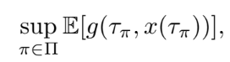
Optimal Stopping Problem
General idea: Stochastic system that transitions probabilistically at each time step and a reward function that assigns a payoff for stopping in state x at time t. Can stop and collect reward or continue in hopes of a greater reward. Goal is to identify policy to maximize expected reward
State: x(t)∈𝝬
Horizon: t = 0,...,T
Actions: A = {stop, continue}
Reward Function: g(t, x)
Policy: 𝝅 = [T] x 𝝬 → A
Stopping time: 𝝉_{𝝅}​=min{t : 𝝅(t,x(t))=stop}
Objective:

Slide 6
Financial Application: American Options
American put payoff: g(t, S_{t} ) = (K - S_{t})⁺ where K is the strike price
Decision: exercise now for immediate payoff vs. wait for better price
Underlying S_{t} ~ GBM or discrete Markov Chain
Variants: callable bonds, convertible bonds, Bermudan/swing options

Slide 7
Low Dimensional Exact Methods
If system dynamics are known and state-space is low-dimensional (both major assumptions!), optimal stopping can be solved exactly
Methods: dynamic programming and partial differential equations (PDEs)
Discrete time steps: Dynamic Programming Approach
Value Function:
Backward induction: compute V(T), V(T-1),..., V(0)
Optimal Policy: stop whenever the immediate reward is at least as large as the expected value of continuing
Continuous times steps: Free Boundary Black-Scholes PDE → Can solve using finite difference method

Slide 8
Curse of Dimensionality
While these exact solutions can be very useful for simple problems, in practice our state space has many dimensions
Only really used in one or two dimensional problems
Exponential growth
If state space is d-dimensional and each dimension is discretized into n points
total number grows with n^{d}
Quickly becomes infeasible with moderate sized d
Ex:
d = 2, n = 100 -> n^{d} = 10⁴ - fine
d = 8, n = 100 -> n^{d} = 10¹⁶ - not fine
Memory + runtime blow up -> need simulation-based methods

Slide 9
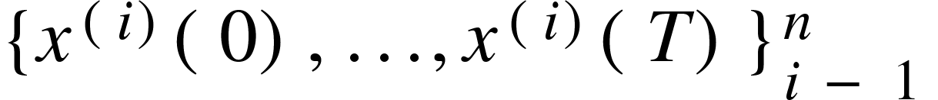
Simulation-Based Approximate Methods
Work on sampled trajectories
Focusing on two main methods:
Least Squares Monte Carlo (LSM) - fit continuation-value regressions
Randomized Policy Optimization (RPO) - directly optimize a smooth policy objective

Slide 10
Linear Policies
Need to adapt optimal stopping problem into something more solvable via optimization
Focus on linear policies
Linear stopping policy considers pre-defined basis functions 𝛟 :
And associated weights

Slide 11
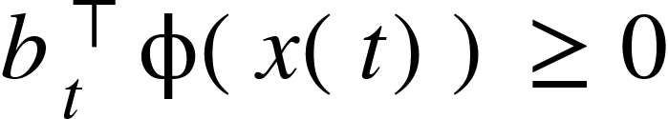
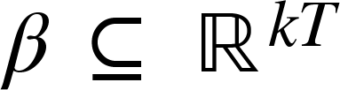
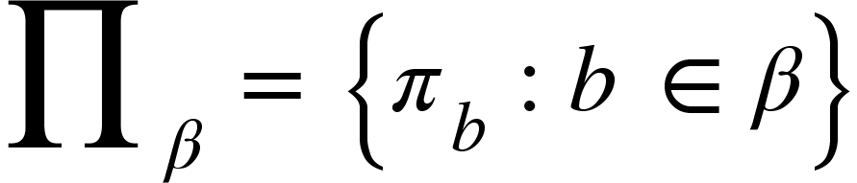
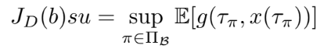
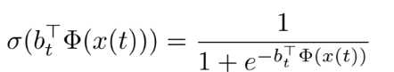
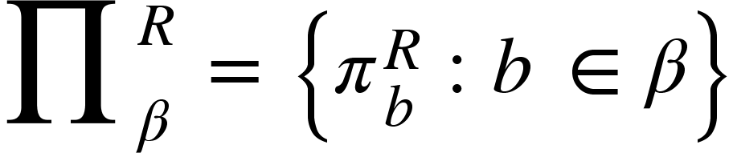
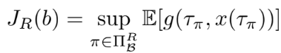
Linear Policies (cont.)
Deterministic Linear Policies:
A linear policy evaluates a predefined set of basis functions and applies a linear decision rule. The policy stops at time t if:
b_{t} is a vector of weights to be learned
Let be the set of all feasible parameter vectors. Let be the corresponding set of linear policies
Objective function of our optimization over b:
Randomized Linear Policies
Doesn’t deterministically stop when the decision boundary is crossed. Stops at time t with a probability determined by applying a sigmoid function
Stops with probability
Let be the set of all feasible parameter vectors. Let be the corresponding set of randomized linear policies
Objective function of optimization:

Slide 12
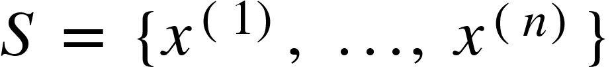
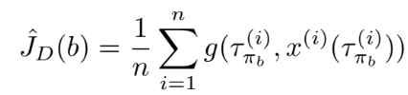
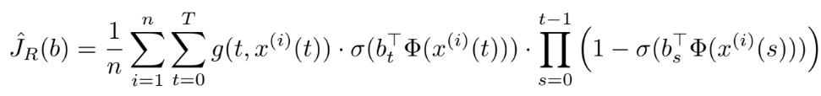
Sample Average Approximation (SAA)
Evaluating objective function even while limiting policy class to linear policies can be challenging
Underlying stochastic process may be complex or not fully known in closed form
SAA replaces the expectation in the objective function with an empirical average over n simulated paths
Let denote a sample of n independent trajectories
Deterministic policy SAA objective:
Randomized policy SAA objective:

Slide 13
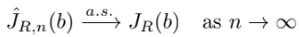
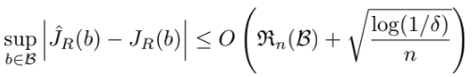
Statistical Properties for Randomized SAA
Convergence (Law of Large Numbers):
Uniform finite-sample bound (with probability 1 - 𝜹)
Complexity of Randomized SAA
Despite introducing smoothness, still non-convex and NP-hard to solve
Heuristic methods perform well in practice
Stochastic gradient descent, coordinate search, multi-start optimization

Slide 14
Equivalence of Policy Classes
Under mild assumptions (constant basis, nondegenerate basis values), deterministic and randomized linear policies are equivalent in terms of maximum achievable expected reward
Randomized = smooth version of deterministic, yet cannot be outperformed

Slide 15
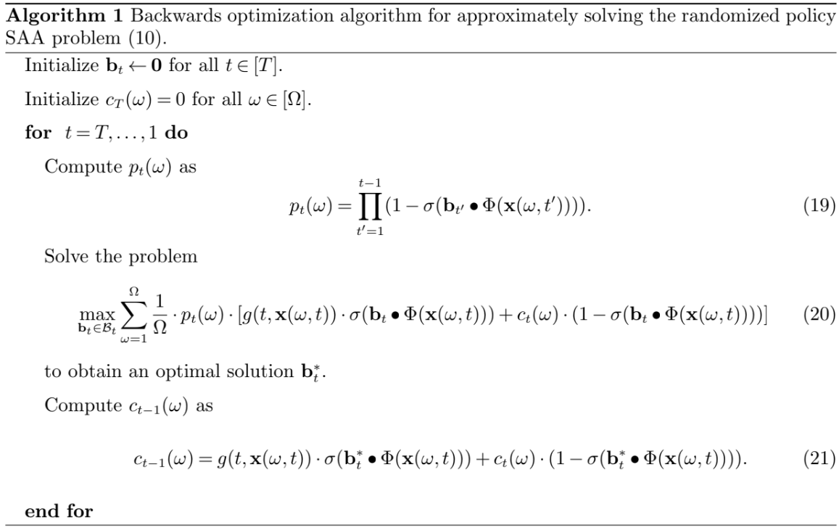
RPO Backward-Optimization Algorithm

Slide 16
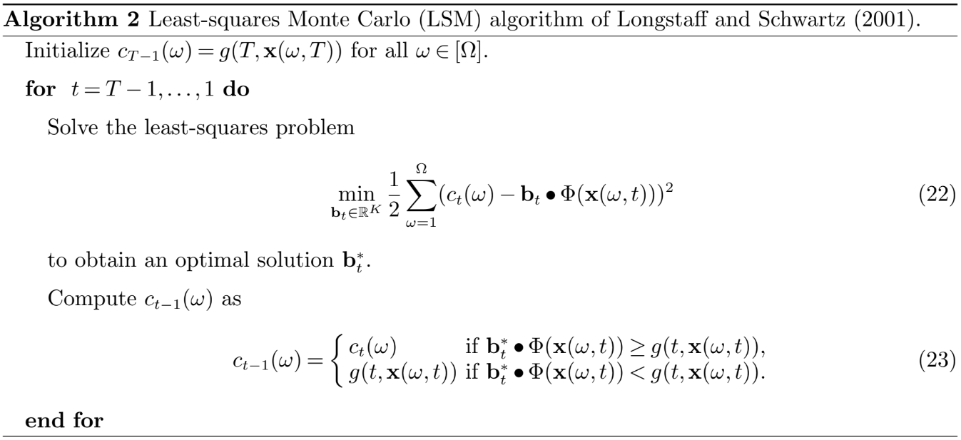
Least-Squares Monte Carlo (LSM) Algorithm

Slide 17
Comparison
In the paper, Guan & Mišić compare RPO and LSM
RPO consistently outperforms LSM in scenarios where the continuation value is difficult to approximate or when dimensionality is high
LSM relies on regression to estimate continuation values
Performance degrades when the approximation quality of the regression model is poor (Ex: structure of basis function highly non-linear)
RPO directly optimizes policy performance
More effectively learns stopping rules even if difficult to approximate value function

Slide 18
Our Experiment: Single-Asset Options
Goal: Compare LSM vs. RPO on American-style option exercise rules in a controlled 1-dimensional setting
Why single-asset?
Transparent exercise boundaries over time and price
Isolate effects of basis choice and algorithmic methodology
Foundation for later multi-asset and real-market extensions

Slide 19
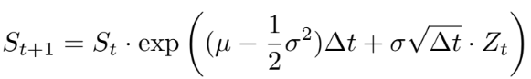
Experimental Design
Established diverse and representative dataset of asset price trajectories using Geometric Brownian Motion:
Parameters:
Z_{t}​∼N(0,1), Δt=1
Initial price S₀ ∈ {80,85,…,115} (8 values)
Drift μ ∈ {−0.005,−0.004,…,0.004} (10 values)
Volatility σ ∈ {0.001,0.002,…,0.009} (9 values)
Trajectories: 5 paths per (S₀,μ,σ) → 8×10×9×5=3,600 total

Slide 20
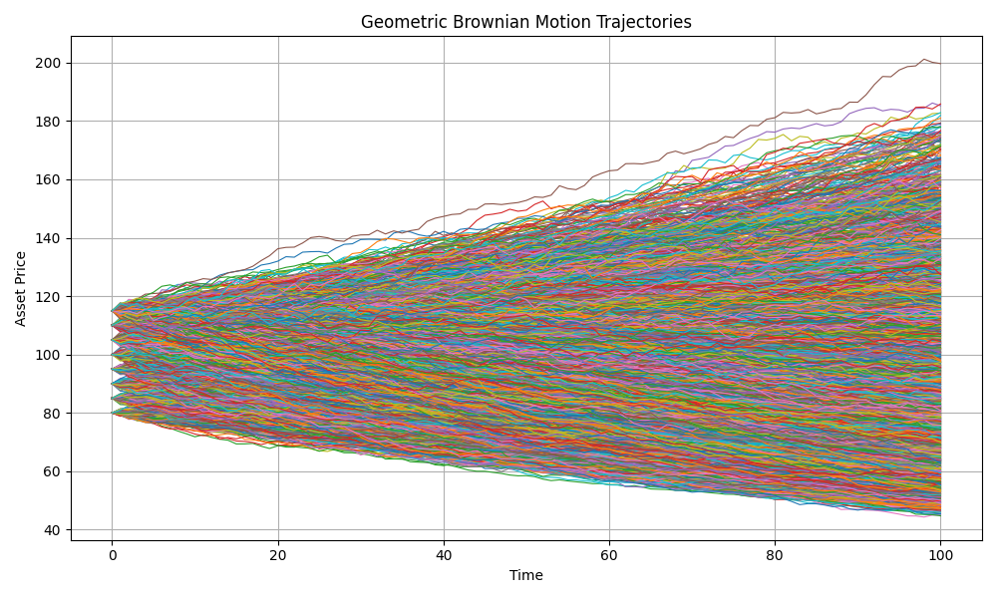

Slide 21
Option Setup
Derivative: Bermudan (time is discretized) American call on single asset
Strike price: K = 100
Payoff at t: max(S_{t} - K, 0)
Decision at each t:
Exercise now and collect payoff
Continue and hope for higher payoff in the future

Slide 22
Basis Function Selection
We use four interpretable features Φ(x):
Constant: ϕ₁(x)=1
bias/intercept
Normalized moneyness: ϕ₂(x)=(x−K)/(x+ε), (ε=10⁻⁵)
Scaled payoff, emphasizes how far in or out of the money the option is
Quadratic moneyness: ϕ₃(x)=(x−K)/(x+ε)²
Captures convexity - continuation value often curves as price moves
Local sensitivity: ϕ₄(x)=exp⁡ ⁣(−∣x−K∣/K)
Exponential decay around the strike
Give extra sensitivity near the strike, where the decision boundary is typically the sharpest

Slide 23
LSM Implementation
Goal: Estimate the optimal stopping boundary using regression on simulated paths.
Backward recursion from terminal time to time 0.
At each timestep:
Compute the payoff for in-the-money (ITM) paths.
Regress future cash flows (continuation values) on basis functions of the current state.
Ridge regression from sklearn.linear_model to prevent overfitting.
Compare immediate payoff vs expected continuation value.
Exercise if payoff > continuation.
Only ITM paths used for training to improve regression relevance.

Slide 24
RPO Implementation
Goal: Learn a probabilistic policy that maximizes expected reward over time.
Backward optimization using the recursive Algorithm 1 from Guan & Mišić.
At each timestep:
Compute probability of non-exercise in earlier timesteps p_t(⍵)
Optimize weights b_t using full-batch gradient ascent.
Torch Adam optimizer for gradient descent, with the loss function set to the negated expected reward:
Use sigmoid of linear combination of basis functions to define exercise probability.
Update continuation values using the new probabilities.
Trained only on ITM paths to reduce noise and improve convergence.
Multiple iterations to stabilize interaction between p_t and continuation values.
Initialized from LSM weights for warm start and faster convergence.

Slide 25
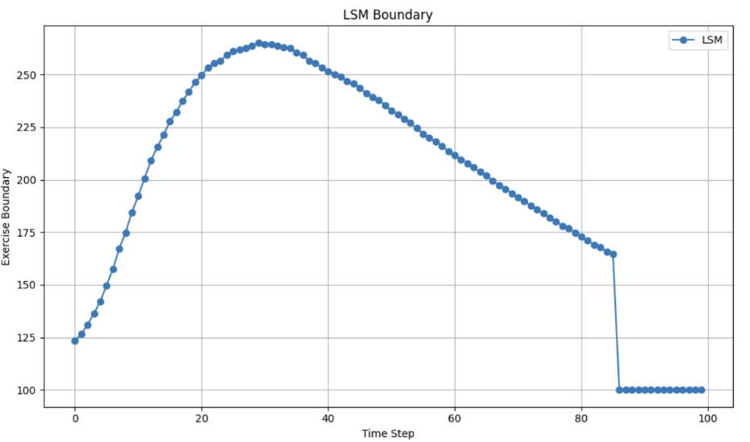
Results - LSM

Slide 26
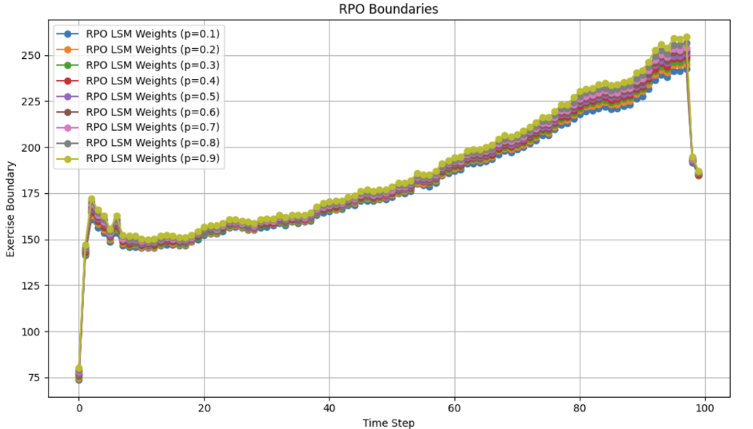
Results - RPO

Slide 27
Results - Discussion
LSM boundary:
Sharp, piecewise curve rising with t then dropping near maturity
LSM regresses against continuation values, which are equal to terminal payoffs at maturity → If current payoff > terminal payoff then exercise immediately
Somewhat reflects classical financial intuition
Option gamma is high near maturity → small changes in underlying price have large effects on option value
RPO boundary:
Probabilistic rule encourages smoother, more gradual transitions
Does not show the same drop in the exercise boundary near maturity
Makes some sense as ITM trajectories at later time steps are more likely to have positive drift μ by our experiment design

Slide 28
End

